Slide 1
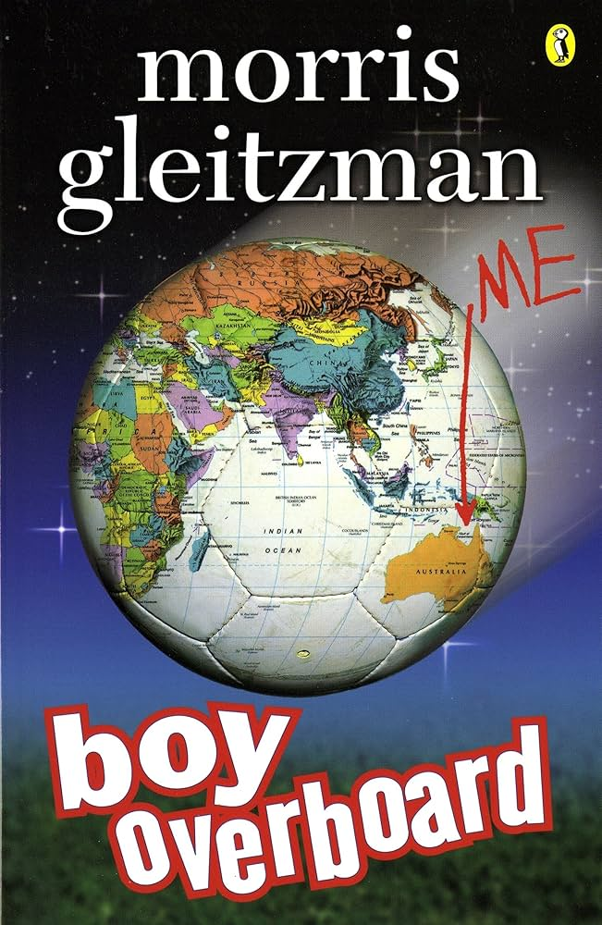
Key Vocabulary Chapters 1 -4
Nerve gas (noun): A poisonous vapour that has a rapid disabling or lethal affect by disrupting the nervous system.
Dazzle: Amaze someone with a splendid display.
Fragments: A small part broken off or separated from an object.
Scramble: A quick or awkward movement.
Tread: A person's manner of walking or the sound made as they walk.
Slither: Move smoothly over a surface with a twisting motion.
Debris: Scattered pieces of waste or remains.
Defiantly: In a rebellious manner.
Ancestors: A person who was in someone's family in past times.

Slide 2
Chapters 1 and 2
1. What sport does the protagonist enjoy playing?
2. What makes the boys stop their game?
3. Why don’t Jamal and the others not go to the other side of the rocket crater?
4. How are Jamal’s parents going against the government's laws?
5. What do we learn about the country Jamal and Bibi live in?
6. In Chapter 2, Jamal makes the following comment to Bibi, “Make sure you tread in your own footprints”. What was the importance of this? Why did she have to tread carefully?
DIG DEEPER Question:
1. “I can’t remember who’s on our side this year anyway.”
What does this line tell us about Jamal’s life and life in his country? 2. Why do you think the author included this line?

Slide 3
Chapter 3
What do we learn about Bibi’s character in these chapters? We learnt that Bibi’s character is…
What is the significance of soccer to Jamal? The significance of soccer to Jamal is…
Why does Jamal say ‘I’m beginning to see why the government wants to keep girls locked indoors’? Jamal says he can see why girls should be locked in doors because...
How does Jamal know what happened to Bibi? Jamal knows what happened to Bibi because…
Draw a picture of Jamal’s standoff with the tank, include some speech bubbles to show what Jamal is saying.

Slide 4
Chapter 4
What does Jamal compare the smell of a land mine to? Jamal compares the smell of a land mine to ......
Why is Jamal's "Don't move" advice a dumb thing to say? It was dumb for Jamal to say "Don't move" because ....
What does Jamal say is the secret of soccer and why does he tell Bibi this? Jamal says the secret of soccer is .......... He tells Bibi this because......
What's Jamal's plan to save Bibi? Jamal's plan to save Bibi is .....
Why is it better for Jamal to be standing on the mine instead of Bibi? It is better that Jamal is standing on the mine because ....
Create a character profile for Jamal. Include what you think he looks like and include different types of character traits (personality traits or qualities) you believe he has based on what we have read so far.

Slide 5
Key Vocabulary Chapters 5-8
Equipped (adj): Provided with all the necessary equipment for its intended purpose.
“Normally our living room is a fully equipped school for eight kids.”
Flickering (verb): To appear for a short time or to make a sudden movement.
“In the flickering candlelight I can see Dad standing at his oven.”
Squabbling (verb): To argue loudly about things that are not important.
“Paint brushes that we’re always squabbling over because there are only three of them.”
Rubble (noun): Broken pieces of stone, brick, etc., from walls or buildings that have fallen.
“We creep into the village through a row of houses that are mostly rubble.”
Indignantly (adverb): In a manner indicating anger or annoyance at something.
“My house has still got a roof,’ says Yusuf indignantly.”
Bemused (adj): Slightly confused by something.
“Mr Nasser is staring, bemused.”
Persecute (verb): To treat someone cruelly or unfairly.
“The government shouldn’t persecute a person just because their brake lights are temporarily out of order.”
Illegal (adj): Not allowed by the law.
“The government has banned TV, so Yusuf’s grandfather has installed his illegal satellite…”

Slide 6
Chapter 5
Why do the kids hide from the truck? They hide from the truck because.....
Why is Bibi dressed like a boy? Bibi is dressed like a boy because ....
Why don't the people in the village notice Bibi? Bibi isn't noticed because .....
Why does Bibi look apologetically at Yusuf? Bibi looks apologetically at Yusuf because...
What does Dad promise Mr Nasser? Dad promises Mr Nasser that .....
How does Jamal know his Dad is actually angry? Jamal knows his Dad is really angry because... SKETCHBOOK
It has been a tough day for Jamal and his friends not to mention Bibi. Use the events from the day to create a timeline that shows the events in the correct order.

Slide 7
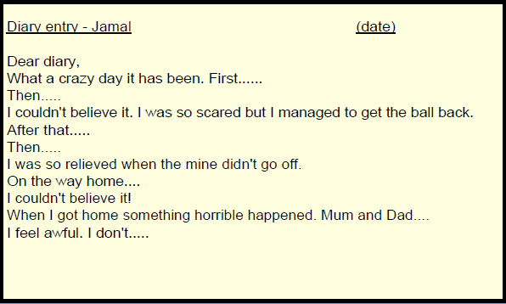
Chapter 6 and 7
Write a diary entry as though you are one of the characters in Jamal's family from Boy Overboard. Describe what is happening and how you are feeling.
Complete in SB.
Challenge: Try to use a range of words used within the text in your diary entry.

Slide 8
Key Vocabulary Chapters 9-12
Imprisoned (verb): To put someone in prison or to keep/lock someone away.
“The neighbours are all asleep too so you don’t get arrested and imprisoned.”
Vivid (adj): Producing powerful feelings or strong, clear images in the mind.
“People in this village have got very vivid imaginations.”
Scurry (verb): Move hurriedly with short quick steps.
“The three of us scurry down the dark alleyway and get into the taxi.”
Straggling (verb): Move along slowly to remain some distance behind the person or people in front.
Confiscate (verb): To take or seize someone's property with authority.
Tattered (adj): Old and torn; in poor condition.
Whimper (verb or noun): Make a series of low, feeble sounds expressive of fear, pain, or unhappiness.
Veer (verb): Change direction suddenly.

Slide 9
Chapter 8 and 9
Where does Jamal's family spend the night? Jamal's family spend the night at ....
Why does Jamal find the Simpson's tea towels scary? Jamal finds the Simpsons tea towels scary because ....
What does Yusuf's grandfather mean when he says "They're saying he's going overboard" when there is no boat on the field? Yusuf's grandfather means....
Does Yusuf's grandfather think the plan will work? Why? Yusuf's grandfather thinks...........because........
Whose voice does Jamal hear coming from the darkness? Jamal hears ....... voice coming from the darkness.
Where are Jamal's mum and dad? Jamal's mum and dad are.....
Why do you think the government has blown up the house? I think the government has blown up the house because.....

Slide 10
Chapter 10 and 11
What do the people in the village think has happened to Jamal's family? How do you know this? The people in the village think that Jamal's family......
Why does Yusuf let Jamal take the soccer ball? Yusuf lets Jamal take the soccer ball because.....
Where do you think Jamal's mum is? I think Jamal's mum is...
Why are the light poles covered in tangled cassette tape? The light poles are covered in tangled cassette tapes because....
Do you think Jamal's parents have really gone to try and convince the government to have a national soccer team? Why do you think that? I think Jamal's parents have gone to............... I think this because........
6. Below you are given a list of events that have happened so far in the text. You need too…
List the events of the day in the order of their importance to the story. Once you have listed the events in order of importance you are to write a sentence for each event to justify WHY you thought that event was more/less important than the other event. Events:
1) Bibi plays soccer with the boys 2) Bibi steps on a landmine 3) Jamal breaks Mr Nasser's window 4) Jamal's parents tell Bibi and Jamal they have to leave 5) Jamal's house blows up.

Slide 11
Chapter 12
Why have the government tied the hands of 7 women? Are they really trying to send a message about females playing soccer? Justify your response. I believe the government have imprisoned 7 women because…
How did Jamal and Bibi recognise their mother? Jamal and Bibi recognised their mother when…
Why do you think so many people went to the stadium? I think all the people went to the stadium…
SKETCHBOOK
4. Think about the story so far... what has been your favourite part? Write a paragraph describing your favourite part of Boy Overboard so far. Your paragraph must include the following information: * A description of the events that take place in that part of the novel * A justification of why it is your favourite part * An explanation of techniques or literary devices the author used to engage you in the text. For example: My favourite part of the story so far was the first chapter of Boy Overboard. It begins with the boys playing soccer. I liked the way Morris Gleitzman described the action as the ball passed between the boys. I thought the way he described how the other boys stopped playing but Jamal continued playing left me wanting more. I think the first chapter gave the reader a strong insight into the personalities of the main characters Jamal and Bibi. Bibi comes across fiery and fearless whereas Jamal is more concealed and guarded. I think the use of dialogue both inner dialogue that Jamal has when faced with something and he thinks through it compared to Bibi’s strong wittedness and attitude when speaking by calling things camel snot etc. is a great way to keep the reader engaged with a little bit of humour.

Slide 12
Key Vocabulary Chapters 13-16
Plough (verb): Move in a fast and uncontrolled manner.
“It ploughs across the open land and stops in a whirl of dust between the tape trees and the shop.”
Lurching (verb): Make an abrupt, unsteady, uncontrolled movement or series of movements.
“It’s hard being patient lying here under these smelly old sacks in the back of this lurching, noisy, cold truck.”
Geography (noun): The study of the physical features of the earth and its atmosphere.
“If we did Australia in geography at school, I must have been daydreaming about soccer at the time.”
Refugee (noun): A person who has been forced to leave their country in order to escape war, persecution, or natural disaster.
“Even the World Cup Final probably doesn’t have as many people as this refugee camp.”
Scowl (noun): An angry or bad-tempered expression.
“Apart from his scowl, he looks kind of friendly.”
Hysterical (adj): A state of uncontrollable, extreme emotion.
“There are hundreds now, shouting, pushing, desperate, hysterical.”
Roadblocks (noun): A barrier or barricade on a road, especially one set up by the authorities to stop and examine traffic.
“I don’t say anything about government roadblocks and helicopters with telescopic sights.”

Slide 13
Chapter 13 & 14
Chapter 13: You will be given a controversial statement.
Your task is to come up with a list of reasons (pros and cons) for why this statement may or may not be true.
For example - Statement: Little Red Riding Hood's mother shouldn't have sent her to grandmother's house by herself.
Agree: It is too dangerous for young children to walk alone through a forest.
Disagree: Children need to learn to be independent. If she knows the way and it is usually safe, she should
be able to go visit her grandmother.
Your statement: Bibi and Jamal should not have been left alone in the shop while their dad went to rescue
their mum.
Record your pros and cons in a T-chart in your reading book.
Sketchbook
Chapter 14: Plan for SMS between two characters from the story.
Choose two characters from the story and imagine that they are communicating via text messaging about an incident that has happened so far in the story. Write at least 7 back and forth texts between the characters that describe what is going on and how the characters feel.
Conversation could be between;
- Jamal and Yusuf
- Bibi/Jamal and Mum
- Bibi/Jamal and Dad

Slide 14
Chapter 15 & 16
How does Jamal describe the crowd at the refugee camp? Jamal says the crowd is…
What does Jamal learn about Australia? Jamal learns that Australia…
Why is there a miscommunication between the driver and Jamal? There is a miscommunication between the Australian driver and Jamal because…
Why is Jamal concerned about food and mines? Jamal is concerned about food and mines because…
Why do you think everyone surrounded the United Nations people? The people in the camp are surrounding the United Nations people because…
What do we learn about refugee camps from these chapters? Why do you think the author chose to show the readers these parts of the refugee camp? In these chapters, we learn that refugee camps are... I believe Morris Gleitzman included these details to…

Slide 15
Key Vocabulary Chapters 17-19
Pleading:

Slide 16
Chapter 17
What does Jamal think the Police are there for? Jamal thinks the Police are there to…
Why does Dad give Jamal a ‘pleading’ look? Dad gives Jamal a ‘pleading’ look because…
Why is dad giving the police money? Dad is giving the police money because…
Where might they have gotten the money from? They might have gotten the money from…
Why might Mum and Dad still be miserable? Mum and Dad might still be miserable because…

Slide 17
Chapter 18
Where are the family at the beginning of Chapter 18? The family are…
Why does Mum say ‘Thank God’ when she sees the plane? Mum says ‘Thank God’ because…
Why does Jamal seem surprised to hear the word ‘boat’? Jamal is surprised to hear the word ‘boat’ because…
What is a smuggler and do you think that the family can trust these people? A smuggler is… I think the family … trust the smuggler because…
Why don’t alarms go off when they scan Mum’s bag? Alarms don’t go off when they scan Mum’s bag because…
How do you think the members of Jamal’s family would feel about them selling the candlestick? Jamal’s family would feel…

Slide 18
Chapter 19
Describe what it is like on the plane. On the plane it is………………………….
What does Jamal realise they will have to do? Jamal realises that they will have to ………………………….
Where do you think the plane is taking them to? I think the plane is taking them to …………………….. because…………………
Sketchbook – Creating a Story Map
Below are a list of key events that have happened so far in Boy Overboard. You must rearrange them, so they are in chronological order. Once you have the events in the correct order you are to create a story map in your sketch books illustrating each key event. - Dad bursts into the stadium to save mum
- Jamal and his family start their journey out of Afghanistan
- Jamal’s family home is blown up
- Jamal breaks Mr Nassar’s window
- Bibi stands on a landmine
- Jamal and Yusuf say goodbye to each other

